Slide 1
Learning goal
Pre-test, discover how much you know about chemistry
The study of chemistry is more than 2000 years old

Slide 2
Success Criteria
Learn how the body of chemistry knowledge has been amassed from its study history
What are elements
Understand the three particles that make up an atom

Slide 3
What are elements?
To answer that, you must know about some history.
Notes:
Did you know the study of chemistry goes back more than 2000 years?

Slide 4
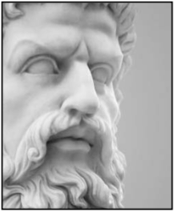
The Ancient Greeks
One of the most influential thinkers of the time was Aristotle (384-322 BCE). He was one of the first people (that we know of) to try to answer the question “what is everything made of?”
He decided that everything was made of just 4 basic constituents, or “elements”; earth, water, air and fire.
What do you think the word “element” might mean?
Aristotle (384-322 BCE)
Notes:
Much of our civilization’s foundations such as government, democracy, citizenship, education and schools, (blame them!) drama, law, public health and medicine, etc, can be traced back to the Greek civilization which flourished over 2,000 years ago
“Element” means the most basic, simple thing.

Slide 5
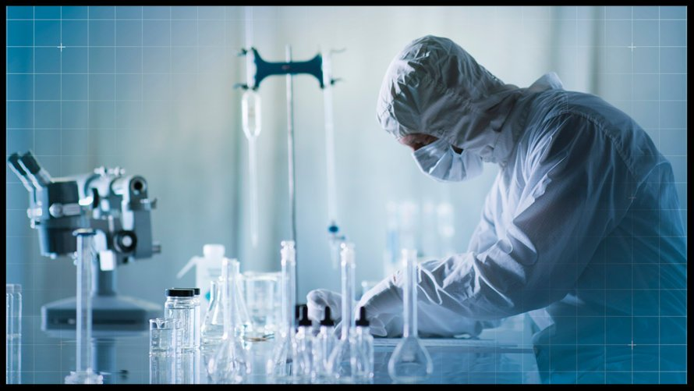
Modern Science
One of the important processes that has been developed in modern science is decomposition. This means to break a substance down into simpler, more basic parts.
Some substances could never be decomposed any further, no matter what was done to them. These became known as “chemical elements”... the most basic substances of all matter.

Slide 6
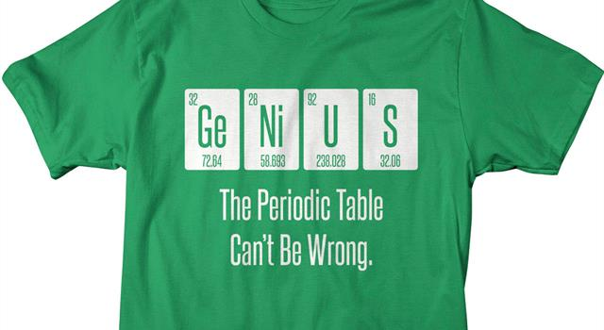
How Many Elements?
We now know that about 90 chemical elements occur naturally on Earth.
Another 20 (or so) can be made artificially in nuclear reactors.
Of these elements, many are very rare.
All the familiar substances on Earth are composed of only about 20-30 of the most common elements.

Slide 7
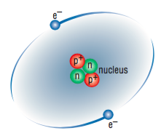
What is an atom?
Atoms are invisible particles that make up all matter.
It was once thought that atoms were indivisible, but scientists now know that
Atoms are made up from even smaller particles called protons (often shown as p), neutrons (n) and electrons (e).

Slide 8

Why are we doing a pre-test?
This is to help the teacher know how much you understand, then at the finish of the topic we shall do another test.
Looking at the difference between this test and the final test will give you and SRC a genuine indication of how much PROGRESS you have made.

Slide 9
Recap What is an element?
An element is a substance that cannot be broken down
Atoms are made up of protons, neutrons and electrons
Protons and neutrons are in the centre of the atom and make up the nucleus
Electrons spin around the nucleus
Protons have a positive charge, electrons a negative charge and neutrons have no charge

Slide 10
Success Criteria
Understand why symbols are used for the different elements
Be able to correctly write the symbols
Learn the symbols for the first 20 elements
Play Chemical Bingo

Slide 11
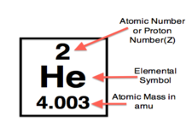
Atomic Number
The atomic number of a chemical element is the number of protons found in the nucleus of an atom.
The atomic number uniquely identifies a chemical element.

Slide 12
Atomic Mass
A property closely related to an atom's mass number is its atomic mass.
The atomic mass of a single atom is its total mass

Slide 13
What is a Chemical Symbol?
A common example of a symbol that you use every day is an emoji on your mobile phone.
You use a smiley face to indicate that you are pleased about something.
Chemical symbols are used in much the same way.
A chemical symbol is a shorthand method of representing an element.
Instead of writing out the name of an element, we represent an element name with one or two letters.

Slide 14
Chemical Symbols
All of these 118 elements on the periodic table have chemical symbols represented by the first letter or two of the name of the element.
If the chemical symbol has two letters the first letter is always capitalized and the second letter is written in lowercase.
For chemical symbols that consist of one letter, that letter is always capitalized.
For example, C represents carbon, Ca for calcium, O for oxygen.

Slide 15
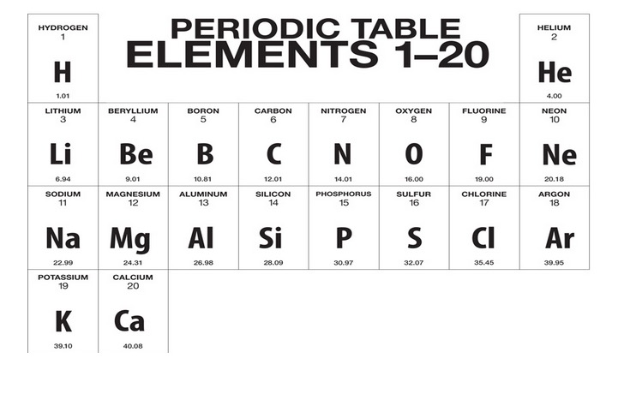

Slide 16
The Periodic Table
The best way to learn about the elements is to study the “Periodic Table”, which is a special list of all the elements.
The first thing to do is to look through it and see how many elements you have already heard of.

Slide 17
